Slide 1
BRAINY CHATBOT

Slide 2

Department of Computer Engineering and Applications GLA University, Mathura Uttar Pradesh, India
MINI PROJECT II
Supervised by:
Mr. Sharad Gupta
SUBMITTED BY:
Prashant Tomar (181500492)
Mansi Goyal (181500370)
Radhika Singh (181500529)
Jaideep Lalchandani (181500290)
Siddhant Gupta (181500708)

Slide 3
Overview Of Presentation:
Introduction
Motivation
Objective
Hardware And Software Requirement
Models
Dataset
Step by step process
Results
Scope for future works
References

Slide 4
Introduction
We have proposed a BrainyChatBot to address the medical problems of people. Here, we will have essential information regarding diseases like Fungal Infection, Allergy, Chronic Reaction, Diabetes, Migraine, AIDS, Chicken Pox, Malaria etc. and their symptoms like itching, muscle pain, increased appetite, polyuria, headache etc. We’ll use decision tree architecture which utilizes the attributes in order to improve disease prediction. Our BrainyChatBot will ask question regarding presence of the symptoms and predict a disease accordingly and will also suggest the doctor for the predicted disease. It will also give the details of doctor like contact number, email address etc.

Slide 5
Motivation
As we all know that “Medical Field” is growing day by day but there is not sufficient medical facilities and equipments available for everyone and it is not possible that we know about each and every doctor and diseases, that’s why to resolve this type of problem we have design a Machine Learning Model that can predict patient diseases on the basis of symptoms and suggest the related doctor.
In order to reduce the work of searching for the specialized doctor from the thousands of resources and helps in saving a lot of time and energy It also helps in the time of emergency as this system helps you to search the perfect doctor for you in no time. “Your help is just few questions away".

Slide 6
Objective
In “Brainy ChatBot” project the objective is to reduce the time which taken by a patient when he or she doesn’t know about their disease and if they know about it other scenario is that they don’t know which doctor they should consult about it. So by this project it will be very easy to analyze our disease at any place just at fingertips.

Slide 7
Hardware And Software Requirements
Hardware Requirements
• Processor - Intel i5
• Operating System – Windows /8/10, Linux, Mac OS
• RAM – 4GB(minimum)
• Hard disk – 64 GB
• Hardware Devices – Computer System
Software Requirements
• Anaconda Navigator
• Spyder
• MS Excel

Slide 8
Dataset
Dataset for the given problem contains 133 diseases entries. In both training and testing datasets the attributes are same.
The diseases in the datasets are:
itching, skin_rash, nodal_skin_eruptions, continuous_sneezing, shivering, chills, joint_pain, stomach_pain, acidity, ulcers_on_tongue, muscle_wasting, vomiting, burning_micturition, spotting_ urination, fatigue, weight_gain, anxiety, cold_hands_and_feets, mood_swings, weight_loss, restlessness, lethargy, patches_in_throat, irregular_sugar_level, cough, high_fever, sunken_eyes, breathlessness, sweating, dehydration, indigestion, headache, yellowish_skin, dark_urine, nausea, loss_of_appetite, pain_behind_the_eyes, back_pain, constipation, abdominal_pain, diarrhoea, mild_fever, yellow_urine, yellowing_of_eyes, acute_liver_failure, fluid_overload, swelling_of_stomach, swelled_lymph_nodes, malaise, blurred_and_distorted_vision, phlegm, throat_irritation, redness_of_eyes, sinus_pressure, runny_nose, congestion, chest_pain, weakness_in_limbs, fast_heart_rate, pain_during_bowel_movements, pain_in_anal_region, bloody_stool, irritation_in_anus, neck_pain, dizziness, cramps, bruising, obesity, swollen_legs, swollen_blood_vessels, puffy_face_and_eyes, enlarged_thyroid, brittle_nails, swollen_extremeties, excessive_hunger, extra_marital_contacts, drying_and_tingling_lips, slurred_speech, knee_pain, hip_joint_pain, muscle_weakness, stiff_neck, swelling_joints, movement_stiffness, spinning_movements, loss_of_balance, unsteadiness, weakness_of_one_body_side, loss_of_smell, bladder_discomfort, foul_smell_of urine, continuous_feel_of_urine, passage_of_gases, internal_itching, toxic_look_(typhos), depression, irritability, muscle_pain, altered_sensorium, red_spots_over_body, belly_pain, abnormal_menstruation, dischromic _patches, watering_from_eyes, increased_appetite, polyuria, family_history, mucoid_sputum, rusty_sputum, lack_of_concentration, visual_disturbances, receiving_blood_transfusion, receiving_unsterile_injections, coma, stomach_bleeding, distention_of_abdomen, history_of_alcohol_consumption, fluid_overload.1, blood_in_sputum, prominent_veins_on_calf, palpitations, painful_walking, pus_filled_pimples, blackheads, scurring, skin_peeling, silver_like_dusting, small_dents_in_nails, inflammatory_nails, blister, red_sore_around_nose, yellow_crust_ooze, prognosis

Slide 9
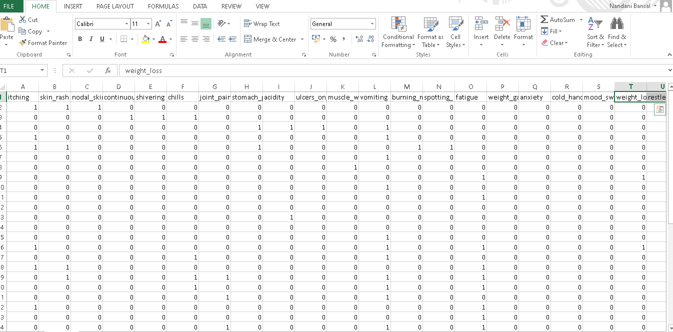
Dataset

Slide 10
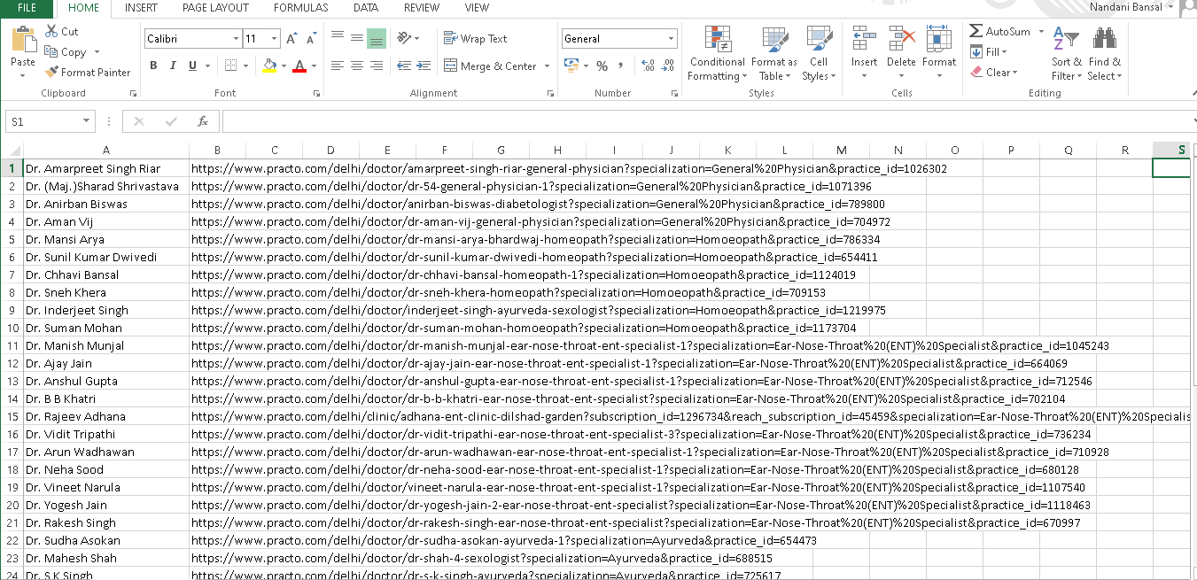
Dataset
The doctor’s dataset contains two attributes:
Doctor’s name , Doctor’s contact information

Slide 11
Our process is easy
User
Symptom
Check
Disease
Prediction
Disease Detection
Doctor
Prediction

Slide 12
Project Contribution
In existing system, it is very difficult to understand the disease properly with only symptoms, for a common person who doesn’t have medical knowledge.
On contrary:
Our project will help in detecting expected disease and also consult best doctor regarding that. So, this will saves our time as well as helps in knowing correct doctor in less time so that treatment will start as early as possible.
Our model if easy to use and gives helpful information in no time.

Slide 13
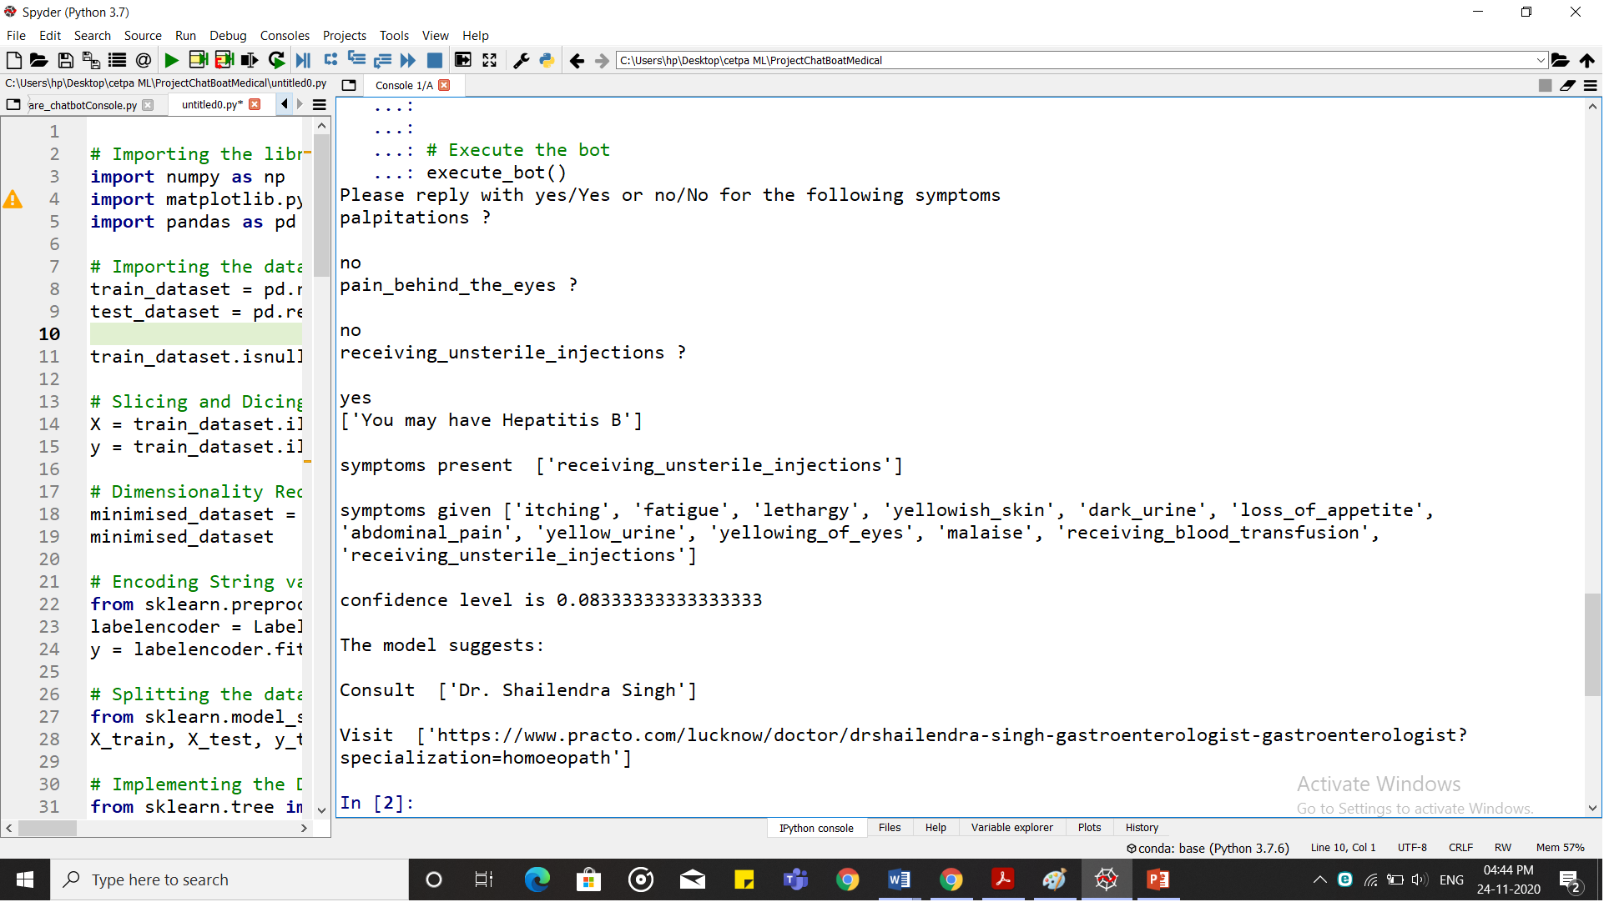
Results
The precise information of the doctor for the particular disease, which was predicted by the symptoms, was predicted and shown.

Slide 14
Scope For Future Works
There are some of the tasks that can be done in future work related to this project study :-
The design of an intelligent system can be prepared that can show the information of doctors, based on the location.
GUI can be developed for more effective use.

Slide 15
References
https://www.analyticsvidhya.com/blog/
https://medium.com/data-science-simplified/
https://data-flair.training/blogs/
https://www.wikipedia.org/
https://www.python.org/
https://pandas.pydata.org/
https://www.geeksforgeeks.org/
https://www.anaconda.com/

Slide 16

THANK YOU

